Slide 1
University of Basrah College of Medicine/ Department of Human Anatomy First Class Medical Biology

Slide 2
Movement of material across plasma membrane
Balqees Alasfoor

Slide 3
Objectives
To know how material can pass through P.M
To know the types and the mechanisms of transport across P.M.

Slide 4
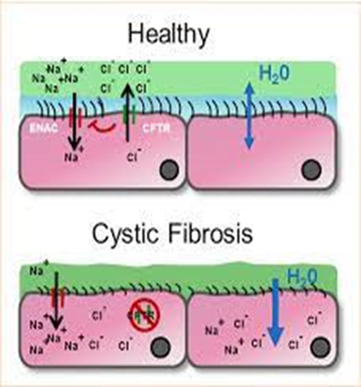
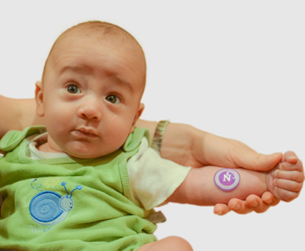
Rania is a 4-month- old baby presented by her mother because her skin always tastes salty when she kissed, the doctor examines the baby and perform some tests then told her that Rania has cystic fibrosis (a problem in the transport of chloride across cell membrane).

Slide 5
Substances can pass across the membrane depends on:
The particles of substances themselves
Concentration gradient
The availability of energy

Slide 6
There are two types of transport mechanism by which molecules traverse membrane:
1-passive transport is the movement of molecules or ions from an area of higher to lower concentration .
Mechanism does not require energy from cells.
2-Other transport mechanism that require energy from cells like active transport and bulk transport mechanisms.

Slide 7
Passive transport can happen through 3 different channels ?
1-lipid bilayer (the lipid soluble goes faster because can easily diffuse through a fatty membrane).
2-pore, channel protein (allows specific substances to enter or leave the cells).
3-carrier protein (integral proteins have receptors that bind with specific molecules to pass through P.M.).

Slide 8
There are four main kinds of passive transport:
Simple or passive diffusion
Facilitated diffusion
Filtration
Osmosis

Slide 9
A- Passive diffusion
Is the net movement of material from an area of high concentration to an area with lower concentration
Diffusion will continue until the concentration gradient has been eliminated.
No membrane proteins are involved

Slide 10
Does not require energy from cells (metabolic energy)
The energy used in the process of diffusion is supplied by the particles themselves for example the rate of diffusion increase with increase in temperature.

Slide 11
Particles that move through the Plasma Membrane through Diffusion
Substances soluble in fat: fatty acid, glycerol some vitamins (A ,D ,E ,K)
Neutral particles :water , oxygen, carbon dioxide

Slide 13
Factors that affect the RATE of diffusion
1-Difference in concentration between the inside and outside of the cell
2. The size of the chemical substance.
3. Temperature
Higher temps = molecules move faster.

Slide 14
4. Whether the chemical substance is water-soluble or lipid soluble.
The lipid soluble goes through faster because the cell membrane is phospholipids and can easily diffuse through a fatty membrane.

Slide 15
B- Facilitated diffusion
Is the movement of molecules across the cell membrane via special transport proteins that are embedded within the cellular membrane.
It differs from passive diffusion in that molecules do not dissolve in phospholipids bilayer but their passage is transport by the proteins.

Slide 16
Also in facilitated diffusion which is a passive process
the solutes move down their concentration gradient and do not require energy for this process.

Slide 17
Large, insoluble molecules, such as glucose and proteins require a carrier molecule to move through the plasma membrane.
It will bind with its specific carrier proteins, and the complex will then be bonded to a receptor site and moved through the cellular membrane.

Slide 19
Two classes of proteins mediate facilitated diffusion
Carrier proteins are specific, each can transport with only a certain type of molecule or ion, which is then transported through the membrane.
For example, various sugar molecules of identical size might be present inside or outside the cell, but glucose can cross the membrane hundreds of times faster than the other sugars. For this reason, the membrane can be called differentially permeable

Slide 20
Channel proteins form unblocked pores.
that allow substances to enter or leave the cell.
Water can pass through phospholipid bilayers by simple diffusion or by facilitated diffusion through special channel proteins called aquaporins.

Slide 21
What is the difference between carrier protein and channel protein?

Slide 23
C- Filtration is movement of water and solute molecules across the cell membrane due to hydrostatic pressure.
Depending on the size of the membrane pores, only solutes of a certain size may pass through it.

Slide 24
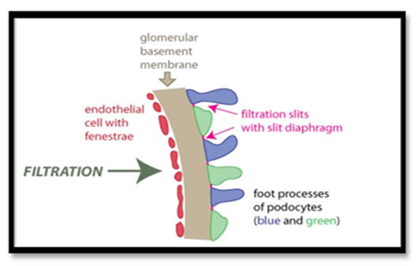
The membrane pores of the Bowman's capsule in the kidneys are very small, and only albumins which is the smallest type of the proteins and soluble in solute solutions, have any chance of being filtered through.

Slide 25
D- Osmosis:
is the movement of water molecules across a selectively permeable membrane.
There are three types of Osmosis solutions:
1-Isotonic solution
is when the extracellular solute concentration is balanced with the concentration inside the cell.

Slide 26
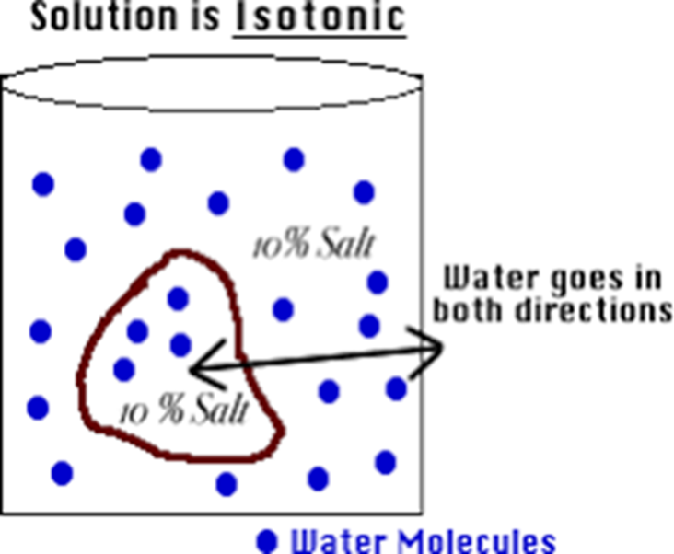
In the Isotonic solution, the water molecules still moves between the solutions, but the rates are the same from both directions
Tissue ﬂuids and blood plasma are isotonic for body cells

Slide 27
2- Hypotonic solution
Is when the solute concentration outside the cell is lower than the concentration inside the cell.
The water moves into the cell, down its concentration gradient (from higher to lower water concentrations).
That can cause the cell to swell up and explode as they cannot become turgid because there is no cell wall to prevent the cell from bursting.

Slide 28
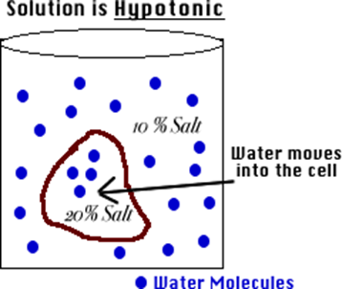
when the cell is in danger of bursting, organelles called contractile vacuoles will pump water out of the cell to prevent this.

Slide 29
3- Hypertonic solutions
Hypertonic solution is when the solute concentration outside the cell is higher than the concentration inside the cell.
In hypertonic solutions, water diffuses out of the cell due to osmosis and the cell shrinks in a process termed crenation.

Slide 31
2-Transport mechanisms (requiring energy from cells)
Why required energy?
The cell needs to transport molecules from low to high concentration and that needs energy
Source of energy?
ATP hydrolysis

Slide 32
There are two main types of transport mechanisms that require energy
A- active transport
B- bulk transport

Slide 33
A- Active transport is the movement of substances like ions against its concentration gradient (from low to high concentration).
Usually associated with accumulating high concentrations of molecules that the cell needs, like ions, glucose and amino acids.
Cell will needs energy(ATP) and carrier protein to transport molecules.

Slide 34
The kidney cells have a large number of mitochondria (to create energy) near membranes where active transport is occurring for re-use needed nutrients from the waste like water, amino acids, vitamins and glucose are reabsorbed into blood stream.

Slide 35
B- Bulk transport
Is the movement of substances or macromolecules across membrane within a small vacuole.
These processes are grouped according to whether materials are moved into or out of the cells.
There are two types of bulk transport:
1-Endocytosis
2-Exocytosis

Slide 36
Endocytosis: cells uptake molecules and particles from surrounding media.
How it works?
Invagination
Endocytosis occurs in one of three ways :
1-Phagocytosis (cell eating)
Cytoplasmic process (pseudopodia) of the cell is extended and surrounds the particles and form vesicle called phagosome.

Slide 37
Phagosomes then fuse with lysosome to form phagolysosome.
Lysosomal enzymes digest the content and the indigested particles are retained within vacuoles which termed residual bodies.
Certain white blood cells like neutrophil and macrophage are specialized for engulfing and removing particles like bacteria and dead cells

Slide 39
2-Pinocytosis (cell drinking)
Occurs when the Plasma membrane folds inward to form a channel allowing dissolved substances to enter the cell.

Slide 40
When the channel is closed, the liquid is encircled within a pinocytic vesicle, which then fuse with lysosomes to hydrolyze (break down) the particles.
These vesicles then fuse with plasma membrane to release their contents outside the cell.
This process is termed transcytosis and requires energy in the form of adenosine triphosphate (ATP).

Slide 42
3- Receptor mediated endocytosis
Is the process by which cells absorb specific extracellular molecules called ligands bind to specific receptors on the cell membrane before they are internalized by invagination.

Slide 45
Exocytosis
Is the opposite of endocytosis
In exocytosis, membrane-bound vesicles containing large amount of cellular molecules like waste products or molecules ( hormones and proteins) for export and transported to the cell membrane .
The vesicles fuse with the cell membrane and expel their contents to the exterior of the cell.

Slide 47
Cystic fibrosis is inherited disease affect the cells that secrete sweat, mucous digestive juices the in respiratory, digestive and reproductive systems where causes severe damage to them.
In normal conditions these secreted fluids are thin and slippery.
In cystic fibrosis disorder, mutation in a gene changes a protein that regulate the movement of salt in and out of cells and causes the secretions to become sticky, thicker as well as increased salt in sweat.

Slide 48
These secreted fluids instead of acting as lubricants, the secretion plug up tubes, ducts and passageways especially in the lungs (fibrosis clogs the tubes that carry air in and out of lungs)
In pancreas the thick mucus can also close the tubes that carry digestive enzymes from pancreas to the intestine and that effect on the function of the intestine which became unable to complete the absorption of the nutrients from the food.

